Slide 1
Toll Management
RedHotTechiePeppers

Slide 2
Overview
The product primarily aims at reducing the traffic density in the toll zones.
This is achieved by automating the existing mechanical Tolls using OCR coupled with Object Tracking.

Slide 3
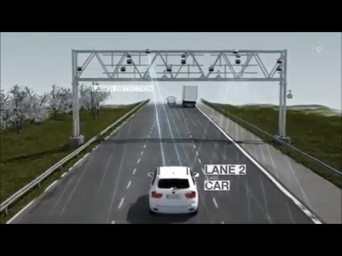
The Product in brief

Slide 4
Issues encountered by the existing system
Issue 1
Issue 2
Issue 3
Increased traffic density at toll zones.
Hindering the smooth flow of ambulance and other public service vehicles through the traffic.
Wastage of crucial time at the toll.
Delays in transfer of time sensitive commodities.
Lack of lane discipline.

Slide 5
Project objective:
Tackling all the issues posed by the existing systems.

Slide 6
Technology involved
The core technology involved in developing the product as a whole
OCR
Image processing
Short Messaging Service

Slide 7
Existing Systems

Slide 8
Manual Toll Collection
System Functionality
Car arrival at the toll system.
Lowering barricade.
Entry of car and journey details by the official.
Physical transfer of funds.
Raise of barricade on payment.
Cons of the system
Process of toll collection approximates at an average of 1 - 1.5 minutes.
Massive accumulation of traffic.
0 lane discipline.
Hindrance in fund transfer.
Requirement of stringent human labor.

Slide 9
RFID Tags
System Functionality
Radio frequency tags provided by ICICI called FASTags.
Tag fixed to the upper central portion of the vehicles windscreen.
Cash deducted from the account linked to the tag.
Vehicle passes through the toll.
Cons of the system
Takes approximately 10 seconds.
Presence of a barricade to stop the vehicle.
Human presence required to account for mishaps.

Slide 10
Proposed deliverables
Deliverable 1
Saves a considerable amount of time at the toll junction per vehicle.
Deliverable 2
Standardizing of number plates nation wide.
Smooth passage of public service vehicles.
Deliverable 3
Installing perfect lane discipline and thus reducing unwanted collisions.
Deliverable 4
Reducing the traffic density at each and every toll junction.

